Slide 1
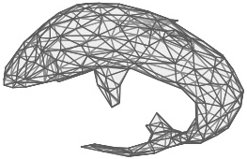
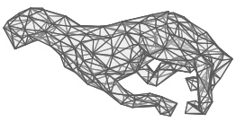
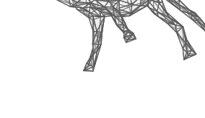
MeshCNN Attention
Tomer Shanny (Albedo)
Dana Cohen (Mitsuba)
Tomer Ronen (Gamut)

Slide 2
Motivation
Pooling: collapsing less important edges
What hints that an edge is “more important” than others?
Paper’s method - features’ L2 norm
Our method – self-attention layers to the rescue!

Slide 3
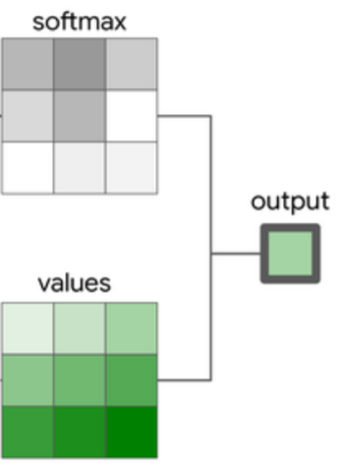
Self attention layer
Learns to create a weighted combination of the input features
For every “word” (pixel, edge), the importance of every other word is determined by the relation between their features.

Slide 4
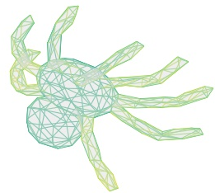
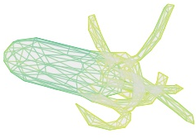
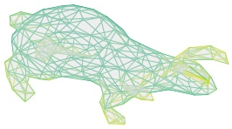
Prioritizing with Attention
mixed_features, attn = attention(features, mesh)
attn [n_edges, n_edges] holds the importance every edge assigns all the others.
edge priority = mean importance

Slide 5
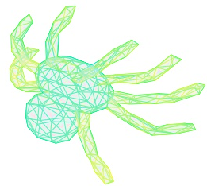
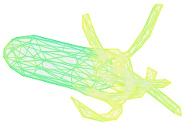
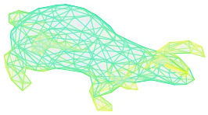
Prioritizing with Attention
mixed_features, attn = attention(features, mesh)
attn [n_edges, n_edges] holds the importance every edge assigns all the others
edge priority = mean importance

Slide 6
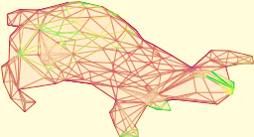

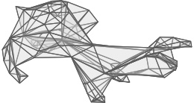

Slide 7
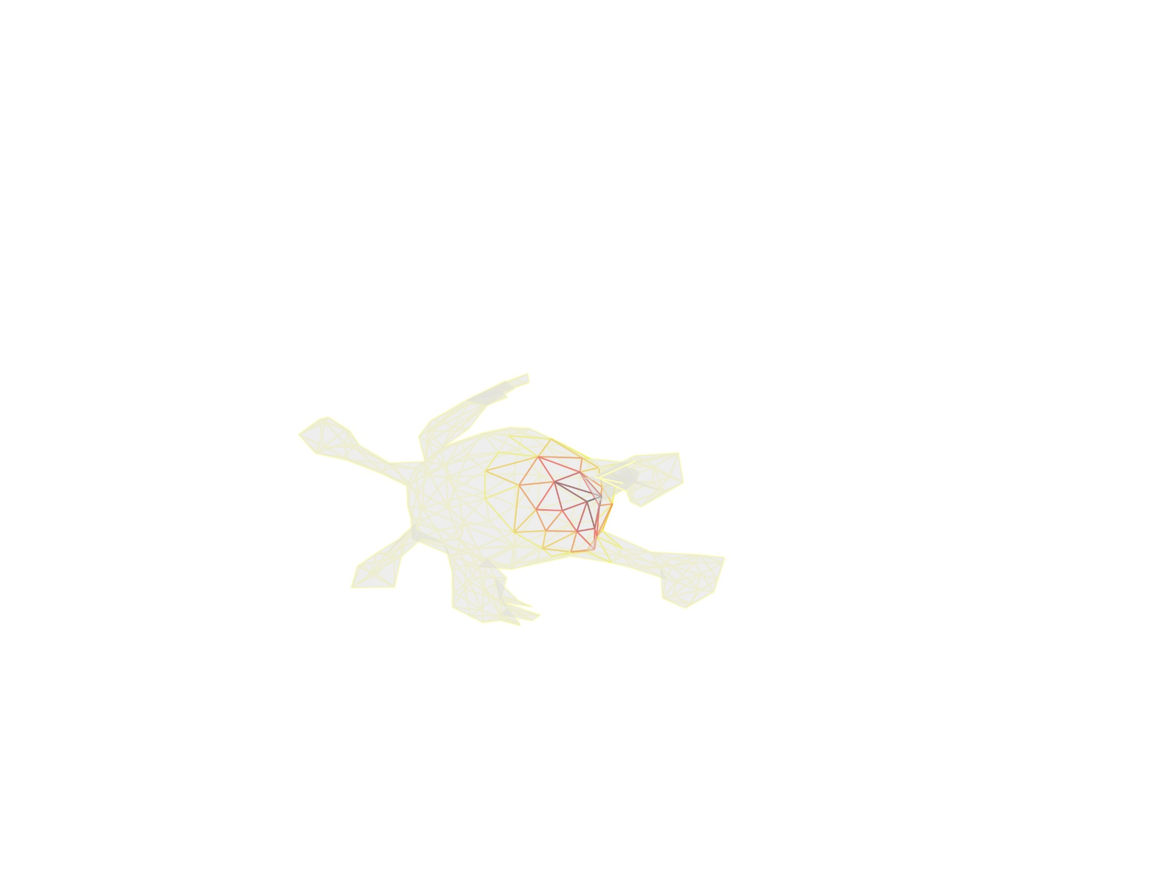

Global vs Local attention
Global: weighted combination of all the edges
Local: weighted combination of the edge’s neighborhood
Neighborhood:
Paper: neighbor $⟺$ share a triangle
We define second (and higher) degree neighbors
Define the dual graph: mesh edge → dual node
Degree = shortest path length (based on BFS)

Slide 8
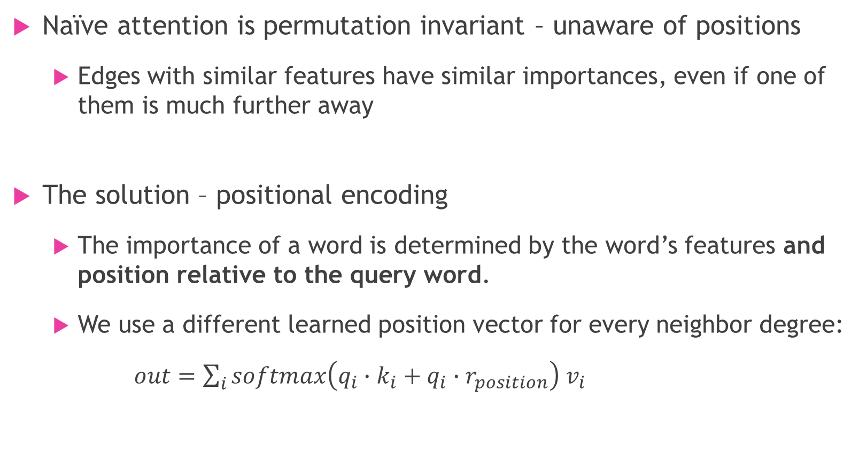
Positional Encoding
Naïve attention is permutation invariant – unaware of positions
Edges with similar features have similar importances, even if one of them is much further away
The solution – positional encoding
The importance of a word is determined by the word’s features and position relative to the query word.
We use a different learned position vector for every neighbor degree:
$out=\sum_{i}{softmax\left(q_{i}∙k_{i}+q_{i}∙r_{position}\right) v_{i}}$

Slide 9
Summary – Our Contribution
Global self attention mechanism for meshes
MeshPool prioritizing with attention values
Local self attention mechanism for meshes
Efficient Cython implementation of shortest paths algorithm
Positional encoding for meshes

Slide 10
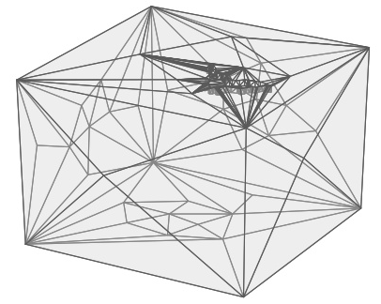
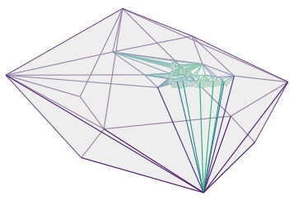
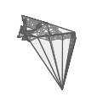
Results
Network | Accuracy
Original | 94.2
More params | 94.2
Global attention | 93.8
Local attention (5-neighbor) | 95.0
Global attention + positional encoding | 97.3
Local attention + positional encoding | 96.8
We also ran:
Shrec_16 & Shrec_10 classification datasets

Slide 11
Bibliography
MeshCNN
Attention is All You Need
Stand-Alone Self-Attention in Vision Models
attention-is-all-you-need-pytorch github.com/jadore801120/attention-is-all-you-need-pytorch
lang-perf github.com/pankdm/lang-perf

